Slide 1
社会实践板块作业
高一7班
邓传琛

Slide 2
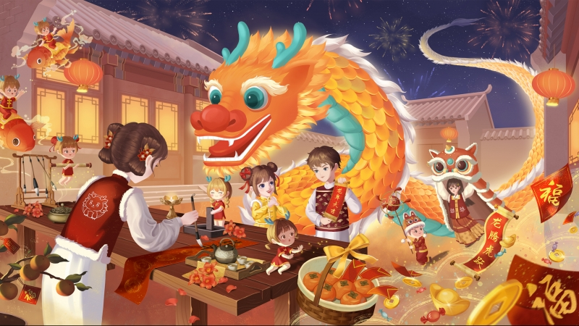
关于“龙”的成语、诗句和对联：
成语：
龙飞凤舞 龙马精神 龙潭虎穴 龙腾虎跃 龙争虎斗
龙行虎步 龙生九子 龙潭虎穴 龙腾虎跃 龙吟虎啸
诗句：
龙腾盛世，风调雨顺；
龙吟虎啸，天下太平。
龙年新年祝词：
值龙年到来，祝愿您身体健康，龙精虎猛，事业蒸蒸日上，家庭幸福美满，财源广进，心想事成。祝您新年快乐，万事如意！
属于我自己的龙年新年对联：
龙腾虎跃迎新春
鸿运当头贺大吉
对联：
龙翔凤舞迎祥瑞
虎啸龙吟庆大吉
miao
Powerpoint
Naturally, those who need it can use it
People who don't need it don't have to look too much
Friends who don't need Naturally, those who need it can use it
People who don't need it don't have to look too much

Slide 3
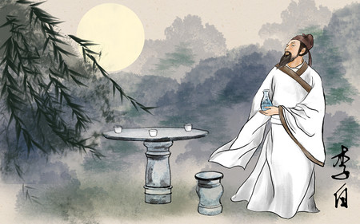
miao
Powerpoint
Naturally, those who need it can use it
People who don't need it don't have to look too much
Friends who don't need Naturally, those who need it can use it
People who don't need it don't have to look too much
刘备（名）：玄德（字）
刘备的名字是刘备，"刘"是他的姓，"备"是他的名，而"玄德"是他的字。"玄"意味深远，"德"意味美德，这个字寓意深邃美好，也反映了刘备个人的品质和抱负。
曹操（名）：孟德（字）
曹操的名字是曹操，"曹"是他的姓，"操"是他的名，而"孟德"是他的字。"孟"是一个常见的名字，而"德"则与“美德”有关，这个字也反映了曹操个人的品质和抱负。
李白（名）：太白（字）
李白的名字是李白，"李"是他的姓，"白"是他的名，而"太白"是他的字。"太"表示极其，超越一般，"白"可能暗示了他的高洁或者清白无暇。
而我字“空明”
miao
Powerpoint
Naturally, those who need it can use it
People who don't need it don't have to look too much
Friends who don't need Naturally, those who need it can use it
People who don't need it don't have to look too much

Slide 4
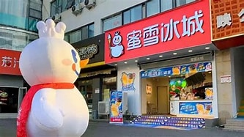
miao
Powerpoint
Naturally, those who need it can use it
People who don't need it don't have to look too much
Friends who don't need Naturally, those who need it can use it
People who don't need it don't have to look too much
蜜雪冰城
这个店铺名称采用了修辞手法中的比喻，将冰城比作蜜糖一样甜美，易于记忆，给人留下美好的印象。同时，使用了“冰城”这个词语，表现出店铺提供的是冰冷饮品，符合奶茶店的属性，也能吸引喜欢冰饮的消费者。
古茗
古茗这个店名有着浓厚的文化气息，使用了“古”这个形容词，表现出这家店铺不仅是卖奶茶的地方，更是有历史和文化底蕴的地方。同时，“茗”也是一个有着古老历史的字眼，这样的名称能够让人联想到传统的茶文化，符合奶茶店的主营业务。
鄰里
这个店名的独特性在于使用了汉字的音译，使店名既能体现本土特色，又能具有国际化的感觉。同时，“邻里”这个词语也呼应了店铺的经营理念——为邻里居民提供优质饮品，加强社区居民之间的联系。店名也用了简短的字眼表达经营理念，易于消费者记忆和口碑传播。
miao
Powerpoint
Naturally, those who need it can use it
People who don't need it don't have to look too much
Friends who don't need Naturally, those who need it can use it
People who don't need it don't have to look too much

Slide 5
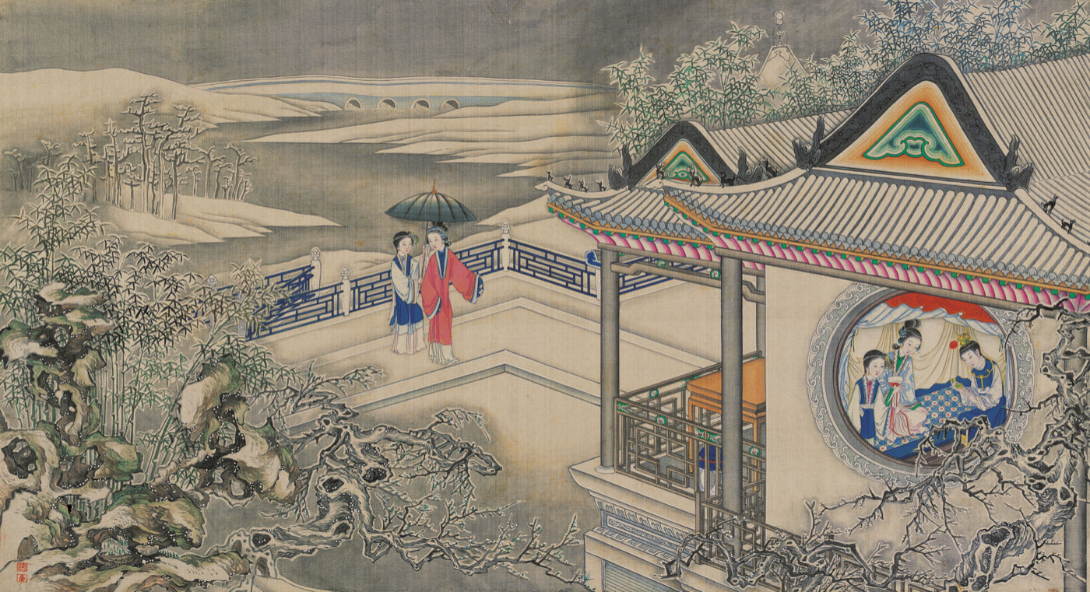
miao
Powerpoint
Naturally, those who need it can use it
People who don't need it don't have to look too much
Friends who don't need Naturally, those who need it can use it
People who don't need it don't have to look too much
1.第一回中，神仙故事和现实故事交织，展示了作者的高超艺术手法。神仙故事中，石头因未被用于修天，落入红尘，预示了宝玉的命运。现实故事则描绘了贾府的繁华景象，体现了作者对人世间的深刻洞察。
2.第二回主要描绘了贾府的人物关系。贾母是家族的精神支柱，贾政和贾赦是家族的经济支柱。贾宝玉是贾母的宠儿，极受贾母宠爱。贾宝玉与黛玉、宝钗等人的关系也在这一回中初步展现。
3.“葫芦僧乱判葫芦案”这个故事是对社会现实的讽刺。通过这个故事，作者揭示了社会上的不公和腐败，同时也预示了宝玉的命运。
4.第五回“贾宝玉入太虚幻境”的内容主要是警幻仙子引着贾宝玉游太虚幻境，先以牌坊警语来教诲宝玉再把金陵众女子的终身册籍（其中暗藏她们的命运）给贾宝玉观赏，后又请他喝“千红一窟” ，命众姐妹演奏《红楼梦》曲词，甚至在最后，把自己的妹妹乳名“兼美”让与宝玉以教授云雨之事。
miao
Powerpoint
Naturally, those who need it can use it
People who don't need it don't have to look too much
Friends who don't need Naturally, those who need it can use it
People who don't need it don't have to look too much

